Slide 1

IBM CAPSTONE PROJECT – The battle of Neighborhoods
Cluster Analysis of London Real Estate Market

Slide 2

Business Problem Section
London Housing Market is in a rut:
Brexit
Hidden price falls
Record-low sales
Homebuilder exodus
Tax hikes addressing overseas buyers of homes in England and Wales.

Slide 3

Solution
Clustering London neighborhoods in order to recommend venues and the current average price of real estate where homebuyers can make a real estate investment.

Slide 4

Data and methodology
Data:
Merging data on London properties and the relative price paid data from the HM Land Registry and data on amenities and essential facilities surrounding such properties from FourSquare API interface.
Mehodology
Collect Inspection Data;
Explore and Understand Data;
Data preparation and preprocessing;
Modeling

Slide 5
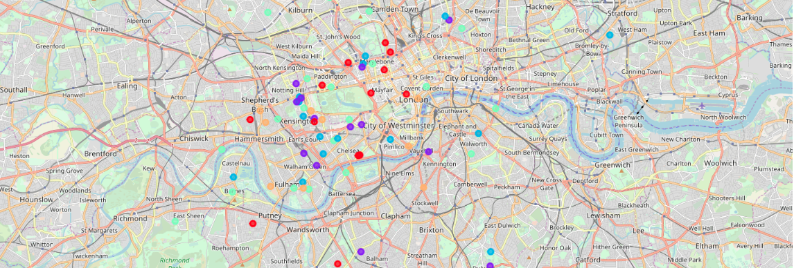
K-Means clustering

Slide 6

Outcome
Examination of real estates according to neighborhoods/London areas
West London (Notting Hill, Kensington, Chelsea, Marylebone) and North-West London (Hampsted) might be considered highly profitable venues to purchase a real estate;
South-West London (Wandsworth, Balham) and North-West London (Isliington) are arising as next future elite venues with a wide range of amenities and facilities.
Examination of real estates by clusters
Clusters 0, 2 and 4 may target home buyers prone to live in 'green' areas with parks, waterfronts;
Clusters 1 and 3 may target individuals who love pubs, theatres and soccer.

